Slide 1
CRNE to NCLEX-RN®
CASN’s role on the road to 2015
Thursday, November 15th, 2012
8:30AM – 10:30AM
Sioban Nelson, RN, PhD, FAAN, FCAHS
Judith McFetridge-Durdle, RN, PhD
Pat Bradley, RN, PhD, MEd, CNE

Slide 2
Time | Item | AGENDA | Presenter
8:30 – 8:40 | 1.0 | Welcome | Sioban Nelson
 | 1.1 | Advocacy Committee (November 2011 – November 2012)
8:40 – 8:50 | 2.0 | Working Group on the New Registration Exam | Judith McFetridge-Durdle
8:50 – 9:30 | 3.0 | A Comparison of the NCLEX-RN® and the CRNE | Pat Bradley
 | 3.1 | Transitioning to Computer Adaptive Testing
9:30 – 9:45 | 4.0 | Considerations for Canadian Educators | Cynthia Baker
9:45 – 10:20 | 5.0 | Open Discussion | All participants
10:20 – 10:30 | 6.0 | CASN’s Next Steps | Cynthia Baker

Slide 3
Introduction
The Advocacy Committee, with oversight from the CASN Board of Directors, took the lead in responding to the announcement that the provincial regulators had chosen the National Council of State Boards of Nursing’s proposal to provide a computer adaptive registration exam to be used in Canada.
Notes:
In accordance with these relevant terms of reference:
Develops strategic initiatives for CASN to influence federal, provincial, and territorial policy.
Establishes partnerships with CASN affiliate organizations to advance nursing education provincially and in the territories
Creates strategies in partnership with other national nursing organizations to respond to major political events such as federal elections, and the renegotiation of the Canada Health Accord.

Slide 4
CASN Advocacy Committee
Sioban Nelson, University of Toronto (Chair)
Evelyn Kennedy, Cape Breton University
Jacinthe Pepin, University of Montreal
Judith McFetridge-Durdle, Memorial University
Linda Ferguson, University of Saskatchewan
Stephen Bishop, Camosun College
Notes:
Representatives from across Canada gave CASN a clear picture of what was happening in each province in regards to the new exam.

Slide 5
Reaction to the Announcement
Position Statement on the Proposed New Entry-to-Practice Nursing Exam, December 2011
CASN President and Executive Director made phone calls to the provincial regulators to obtain more information about the new exam
Notes:
The message Position Statement outlined concerns about the new exams, and stated that educators should be consulted during this process.
CASN’s president and executive director made phone calls to each regulatory body to gather more information.

Slide 6
Communication
In April 2012 CASN sent a letter to the Deans and Directors detailing CASN’s efforts to obtain information, and what was known at that point
At the same time, CASN sent a letter to the Canadian Nursing Students’ Association detailing CASN’s actions and the organizations desire to ensure a successful transition to the new exam

Slide 7
Communication
Communication with the Canadian Council of Registered Nurse Regulators resulted in a meeting between Cynthia Baker and Anne Coghlan (CCRNR President and President and CEO of the College of Nurses of Ontario)

Slide 8
Actions
Cynthia Baker attended the NCLEX Conference in Boston in September 2012, to gather more information about the NCLEX-RN®
Formation of a Working Group
Notes:
The Advocacy Committee agreed that it would be best to create a Working Group of individuals with experience teaching in the United States/knowledge of the NCLEX. Judy, a member of the Advocacy Committee, volunteered to Chair this new Working Group.

Slide 9
Working Group on the New Registration Exam
Judith McFetridge-Durdle, Memorial University (Chair)
Evelyn Kennedy, Cape Breton University
Julie Gibler, Victoria Island University
Noreen Frisch, University of Victoria
Pat Bradley, York University
Zoraida Beekhoo, University of Toronto
Notes:
Educators from across Canada with experience teaching in the US/abundance of knowledge about the NCLEX-RN®

Slide 10
Terms of Reference
Develop an information brief to share at Council concerning key differences between the National Council Licensure Examination (NCLEX) and the Canadian Registered Nurses Examination (CRNE);
Highlight areas that may affect test-taking performance of Canadian nursing program graduates on the new registration exam for educators;
Identify strategies that could support educators in the transition to the new exam; and,
Keep abreast of information coming from the Canadian provincial regulatory bodies and the National State Boards of Nursing in regards to the new exam.

Slide 11
Actions
The Working Group adopted the Terms of Reference on June 26th, 2012
The Group met in August and October via teleconference in order to fulfill the goals outlined in the Terms of Reference
Notes:
Working Group meetings: June 26th, August 22nd, October 4th

Slide 12
Outcomes
Comparing the 2010-2015 CRNE and the 2013-2015 NCLEX-RN®; Condsiderations for Nurse Educators in Canada
Considerations Regarding the NCLEX-RN® for Nurse Educators in Canada
Companies Offering NCLEX-RN® Preparation Resources
Notes:
The Comparing the 2010-2015 CRNE to the 2013-2015 NCLEX-RN®: Condsiderations for Nurse Educators in Canada is a large document that uses a variety of factors to compare the NCLEX and the CRNE. The purpose of this document is to inform educators about differences and similarities of the two exams, so that educators are fully informed as we move towards implementing the exam in 2015. CASN collected the information from the Canadian Nurses Association and National Council State Boards of Nursing websites, the official test plans for the exams, and the 2012 NCLEX Conference.
The one-pager considerations document summarizes some of the major differences between the two exams, and suggests considerations that should be made by Canadian educators in order to help their students be successful in passing the NCLEX in 2015.
The industry of NCLEX preparation in the United States is huge. This document provides an overview of companies that offer NCLEX preparation resources for students and faculty. This not an exhaustive list of available resources. They are the most commonly used. CASN is not promoting any of these resources and has no affiliations with these companies.
Introduce Pat….

Slide 13







Comparing
The 2010-2015 CRNE
and
the 2013-2015 NCLEX-RN®:
Considerations for Nurse Educators in Canada

Slide 14
Exam Test Plans
Both exams assess entry level knowledge and skills
  NCLEX-RN® is based on a job analysis of US new graduates with less than 6 months experience
  CRNE is based on competencies
Based on different (although similar) legal, ethical, and regulatory documents.

Slide 15
NCLEX-RN® Item Writing
Questions based on two textbook references (both exams)
Potential item writers apply to the National Council of State Boards of Nursing/provincial regulatory bodies
Notes:
It is unknown if Canadian textbooks will be able to be referenced in the item writing.

Slide 16
NCLEX-RN® Item Writing
Canadians will be able to item write for the NCLEX-RN®
On the French CRNE exam 50% of items were originally written in English and translated. The other half were written in French

Slide 17
Taxonomies
NCLEX-RN® uses Bloom’s taxonomy for coding test items: knowledge, comprehension, application and analysis
  Most items are at application and analysis levels
CRNE tests the cognitive and affective domains
  10% knowledge and comprehension
  40% (minimum) application
  40% (minimum) critical thinking

Slide 18
Integrated Processes
NCLEX-RN® questions include processes fundamental to nursing:
  Nursing process (clinical reasoning, assessment, analysis, planning, evaluation)
  Caring
  Documentation and communication
  Teaching and learning
Notes:
Canadian students would be competent in these areas.

Slide 19
Clinical Priorities
The NCLEX-RN® prioritization system for clinical practice reflects a structured hierarchy for nursing intervention priority questions that Canadian students will need to learn to be successful on the exam.
Notes:
Examples of the priorities taught in the states are:
Maslow’s Hierarchy of Needs
1st – physiological
2nd – safety and security
Policies and Procedures
1st – activities with strict timelines
2nd – activities that affect patient care

Slide 20
Clients
The client in the CRNE may be a family or a community whereas it is an individual, family or group but not a community in the NCLEX-RN®

Slide 21
CRNE
Question Categories | Percentage
Professional Practice | 14-24%
Nursing-Client Partnership | 9-19%
Nursing Practice: Health & Wellness | 21-31%
Changes in Health | 40-50%

Slide 22
NCLEX-RN®
Question Categories | Sub-categories | Percentage
Safe and Effective Care Environment | Management of Care | 17-23%
 | Safety and Infection Control | 9-15%
Health Promotion and Maintenance |  | 6-12%
Psychosocial Integrity |  | 6-12%
Physiological Integrity | Basic Care & Comfort | 6-12%
 | Pharmacological and Parenteral Therapies | 12-18%
 | Reduction of Risk Potential | 9-15%
 | Physiological Adaptation | 11-17%

Slide 23
Question Categories
Professional Practice (CRNE) is similar to Management of Care (NCLEX-RN®)
  Both approximately 20% of questions
Nurse patient relationship is 10% of CRNE questions, but is an integrated process on the NCLEX-RN®

Slide 24
Question Categories
Health and Wellness (CRNE) and Health Promotion and Maintenance NCLEX-RN® is
- 25% of the questions in the CRNE
- 10% of the NCLEX-RN®
CRNE includes questions on population health, community as client, primary health care, determinants of health
NCLEX-RN® is more focused on individual health alterations

Slide 25
Question Categories
Alterations in health
  NCLEX-RN® focuses on pathophysiology, medical diagnoses, physical assessment, lab values, and technical aspects of care
  CRNE focuses on disease and disease management integrated into a holistic approach

Slide 26
NCLEX-RN® Examples
Safe and effective care environment
Management of Care
  Use information technology
  Comply with state/federal regulations for reporting client conditions (abuse/neglect, gun shot wound, dog bites)
  Participate in performance improvement/QI
  Advance Directives (Durable Power of Attorney)

Slide 27
NCLEX-RN® Examples
Safe and effective care environment
Safety and Infection Control
  Identify which clients to recommend for discharge in a disaster situation
  Use ergonomic principles
  Participate in institution security plans (bomb threats)

Slide 28
NCLEX-RN® Examples
Physiological integrity
  Perform irrigations (eye, ear, bladder)
  Apply pathophysiological…
  Manage care of a patient with a pacing device
Pharmacological and parenteral therapies
  Insert, maintain, and remove IV
Reduction of risk potential
  Evaluate invasive monitoring data (pulmonary artery pressure, intracranial pressure)

Slide 29
Question Formats
Both exams pilot questions for future version of the exam (they do not count in candidate’s score).
CRNE is a multiple choice exam (60% case based)
NCLEX-RN® uses various question formats other than multiple choice
  hot spots (identify area on a graphic)
  fill in the blank
  drag and drop (ranking)
  audio
  chart/exhibit
  multiple response

Slide 30

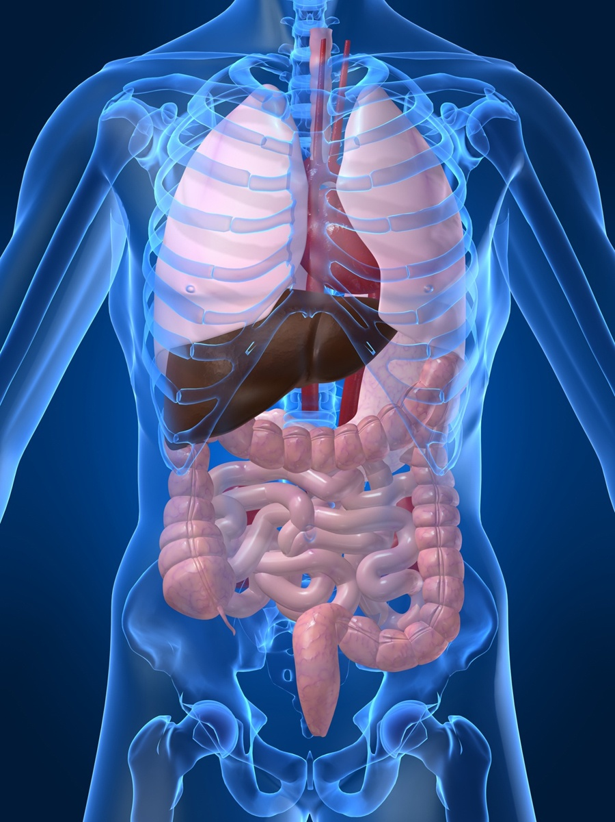
Hot Spot
During the admission assessment the client tells the nurse that he has a history of mitral valve stenosis. While auscultating the client’s heart sounds, to which area on the chest should the nurse apply the stethoscope to listen for mitral valve sounds? (Click the chosen location. To change, click on the new location.)

Slide 31
Drag and Drop
The nurse is performing a respiratory physical assessment on a client. In what order should the nurse assess this client? (Arrange the first item on top and the last item on the bottom.)
A. Percussion
B. Palpation
C. Inspection
D. Auscultation
Sample supplied by HESI courtesy of Bonnie Hobbins

Slide 32

Audio
The nurse is auscultating an adult client’s chest for heart sounds and hears the following sounds.
Which description best describes the client’s heart sounds?
Rate 160 beats/minute, rhythm - regular, tachycardia
Rate 110 beats/minute, rhythm - irregular, with S3 gallop
Rate 100 beats/minute, rhythm - regular, normal sinus rhythm
Rate 16 0beats/minute, rhythm - irregular, with murmur
Sample supplied by HESI courtesy of Bonnie Hobbins

Slide 33
Chart/Exhibit
INFORMATION IN CLIENT’S CHART
History and Physical | Prescriptions | Diagnostic Results
Diagnosis: Glaucoma CHF Findings: 1+ pitting edema lower extremities, bilaterally | betaxolol (Betopic) eye drops one drop in each eye at bed time. hydrochlorothiazide 25 mg PO Daily metoprolol (Lopressor) 25 mg PO Daily | Electrocardiogram: Sinus Bradycardia, rate 52
The nurse reviews the history and physical examination documented in the medical record of an elderly client during a clinic visit. Which action by the nurse is the priority?
Ask if the client takes over-the-counter antihistamines
Instruct the client to elevate both legs when sitting and lying.
Notify the healthcare provider of the use of Betoptic eye drops.
Take the client’s vital signs, including the oxygen saturation level.
Sample supplied by HESI courtesy of Bonnie Hobbins

Slide 34
Exam Format
The CRNE is a paper and pen exam where candidates must answer 180-210 questions over four hours
The NCLEX-RN® is a computer adaptive test, where candidates answer a minimum of 75 and a maximum of 265 questions or 6 hours (until the computer can determine with 95% confidence that the candidate has passed).
  (maximum length rule and run-out-of time (ROOT) rule many mean failure)

Slide 35
CRNE Passing Standard
Different for each version of the exam
Pass rates have varied from 59%-68%
The standard is set by the Examination Committee, who consider factors such as
  the degree of difficulty of the exam
  information about preparation of new graduates
  past performance on the CRNE, and other relevant research findings

Slide 36
NCLEX-RN® Passing Standard
Determined by a panel of judges using the Modified Angoff Method (i.e. judges rate how a minimally competent candidate would perform on a set of items)
The aggregation of the ratings determines a pass mark
This study, and other available evidence, is reviewed by policy-makers who determine the final passing standard

Slide 37
Pass Rates
Pass rates on the CRNE (for first time Canadian writers) ranges from 90-96%
Pass rates on the NCLEX-RN® (for first time American writers) ranges from 86-91%
Pass rates for IENs is far lower on the NCLEX-RN® (27-36%) than the CRNE (61-70%)

Slide 38
Re-Writing Policies
There is a limited number of times that the CRNE can be written. In many states, unlimited re-writes of the NCLEX-RN® are allowed
Notes:
After three re-writes, the candidates must have a review by their provincial regulatory bodies, before they can re-take the CRNE.
Candidates must wait 45 days before re-writing a test, for a maximum of eight times per year.

Slide 39
Transitioning
to
Computer Adaptive Testing

Slide 40
Computer Adaptive Testing (CAT)
Computer adaptive testing is not just a matter of being accustomed to working on a computer
Notes:
The change from a paper and pencil exam to a computer adaptive test will affect Canadian students.

Slide 41
Answering on a CAT
Students cannot highlight/underline as they would on a test paper
Students cannot change their answers
Students cannot go back to complete questions they left blank

Slide 42
Computer Adaptive testing
Reading Speed
  Participant’s reading 20-30% slower from a computer screen than a paper (i.e. Belmore, 1985)
Reading Accuracy
  Reading accuracy and the degree of accuracy in proof-reading tasks lower for a computer based testing (Gould, 1987; Osborn & Holton, 1988)

Slide 43
Computer Adaptive testing
Comprehension
Information/material presented on a computer screen resulted in poorer understanding by the participants than the information presented on the paper (Noyes & Garland, 2008)
Time to Answer Questions
Participants took more time to answer questions on the computer (Noyes & Garland, 2008; Bodmann & Robinson, 2004)

Slide 44
Computer Adaptive testing
Student anxiety varies (Vrabel, 2004)
When tasks are moved to the computer equivalency is often mistakenly assumed (Noyes & Garland, 2008)

Slide 45
Canadian Context
Ongoing research at Cape Breton University
Preliminary research shows that Canadian faculty and students will encounter challenges in transition to computer adaptive testing

Slide 46
CBU Research: Predictors of NCLEX Success/Failure
Failure
  Students with a low GPA, lower education level, who are raising a family or employed (Alameida et al., 2011; Heroff, 2009)
  ESL students (Olson, 2012)
  Course failure, lower marks in science and pathophysiology (Uyehara et al., 2007)
Success
  Average above 80%, no course failure

Slide 47
CBU Research: Potential Challenges of CAT
Student unfamiliarity
  Linked to anxiety
Faculty unfamiliarity
  Lack of time, expertise and resources
  Lack knowledge of resources to best help students
  Potential benefits include less time grading and more statistical feedback (Frein, 2011)

Slide 48
CBU Research: Computerized Assessment Testing Products
Important to be cognizant of the fact that these products are offered by commercial entities
Prediction of success sometimes based on review of high-achieving students (Harding, 2010)
Evidence from many schools of nursing in support of implementation of commercial product designed to improve NCLEX results
Notes:
Harding (2010): Earlier studies which found that the HESI Exit Examination was 96.4% to 98.3% accurate was based on a calculation of the pass rate for those students who were already considered high scoring (90% or higher). When HESI Examination scores are used in logistic regression models, they are useful only in predicting NCLEX-RN success, not failure.

Slide 49
CBU Research: Computerized Assessment Testing Products
Progression Testing
  Use of purchased computer adaptive exams throughout nursing program
  Students receive ample experience
  Cost can be included in tuition or required for students to purchase
  Risk of developing false sense of security (Heroff, 2009)
Intermittent Testing
  Specific time points (entrance, junior year, exit exam)
Notes:
Heroff 2009 study showed that students that did well on progression testing were at risk of neglecting to sufficiently prepare for the NCLEX

Slide 50
Computerized Testing and NCLEX Success
Helps identify failure risk early in education, allowing time for intervention (Heroff, 2009)
Risk of becoming a self fulfilling prophecy (Seldomridge and DiBartolo, 2004)

Slide 51
CBU Research: Clickers in the Classroom
Use of clickers in response to multiple choice questions
Helpful in engaging students
Anonymous responses
Helped faculty understand areas requiring further clarification

Slide 52
Considerations for Canadian Educators

Slide 53
What We Know
Canadians will be recruited as item-writers
Test plan for the April 2013 – April 2016 NCLEX- RN® is now available
NCSBN/CCRNR webinars (English and French) in December 2012; Conference in April

Slide 54
What We Know
June-August 2014 tutorials will be available for students
2013-2014 CCRNR will be organizing panels for Canadian educators to review questions on a weekly basis to block those Canadian students would be unable to answer
Transition team of regulators has been established

Slide 55
Still Unknown
Process for translation
The number/locations of testing centers that will open in Canada
How the panel of Canadian educators will be selected
How the questions will be selected by the panel

Slide 56
Open Discussion
Notes:
Invite participants to comment/question the presenters, tell CASN what information they would like, or how CASN can support them.

Slide 57
Questions/comments for the presenters?
What additional information do you require?
How can CASN support you?

Slide 58
Next Steps
Possibility of hosting a conference on the NCLEX-RN® for Canada educators

Slide 59
References
Alameida, M. D., Prive, A., Davis, H. C., Landry, L., Renwanz-Boyle, A., and Dunham, M. (2011). Predicting NCLEX-RN success in a diverse student population. Journal of Nursing Education, 50(5), 261-267.
Belmore, S. (1985). Reading computer presented text. Bulletin of the Psychonomic Society, 23, 12-14.
Bodmann, S. M. and Robinson, D. H. (2004). Speed and performance differences among computer-based and paper-pencil tests. Educational Computing Research 31(1), 51-60.
Frein, S. (2011). Comparing in-class and out-of-class computer-based test to traditional paper-and-pencil test in introductory psychology courses. Teaching of Psychology, 38(4), 282-287. doi:10.1177/0098628311421331
Gould, J. (1987). Reading from a CRT display can be as fast as reading from paper. Human Factors: The Journal of the Human Factors and Ergonomics Society 29(5), 497-517.
Harding, M. (2010). Predictability associated with exit examinations: A literature review. Journal of Nursing Education, 49(9), 493- 497. doi:10.3928/01484834-20100730-01
Heroff, K. (2009). Guidelines for a progression and remediation policy using standardized tests to prepare associate degree nursing students for the NCLEX-RN at a rural community college. Teaching and Learning in Nursing, 4, 79-86. doi:10.1016/j.teln.2008.12.002
Noyes, J. M. and Garland, K. J. (2008) Computer – v.s. paper-based tasks: Are they equivalent? Ergonomics 51(9), 1352- 1379
Osborne, D.J. and Holton, J. (1988). Reading from screen v.s. paper: There is no difference. International Journal of Man-Machine Studies. 28, 1-9.
Seldomridge, L., and DiBartolo, M. (2004). Can success and failure be predicted for baccalaureate graduates on the computerized NCLEX-RN? Journal of Professional Nursing, 20(6), 361-368. doi:10.1016/j.profnurs.2004.08.005
Uyehara, J., Magnussen, L., Itano, J., and Zhang, S. (2007). Facilitating program and NCLEX-RN success in a generic BSN program. Nursing Forum, 42(1), 31-38.
Vrabel, M. (2004). Computerized versus paper-and-pencil testing methods for a nursing certification examination: A review of the literature. CIN: Computers, Informatics, Nursing 22(2), 94-98.

Slide 60
Thank you!

