Slide 1
You are a student nurse and have arrived on a general surgery floor for your first shift. One of the clients/patients assigned to you is restricted to bed and has a stage II pressure ulcer on his buttocks. You notice that the nurse looking after this gentleman positioned him using a ‘donut’ to relieve pressure over the pressure ulcer, but seem to recall learning that ‘donuts’ only shift pressure to new areas of the body.
What would you do?
Notes:
Recommendation: have this slide visible to students as they enter the classroom, and allow them a few minutes to read it over at the start of class
Ask students for ideas of what they would do if they found themselves in this situation
You may or may not want to comment on their responses – this scenario is meant to get them thinking about how to provide evidenced-base care

Slide 2
Providing Evidenced-Informed Nursing Care:
Gathering, Assessing and Using Information & Knowledge
Notes:
As the scenario highlighted, providing evidenced-based care requires several skills
These skills include (1) finding (or retrieving) evidence, (2) assessing (or reviewing) the quality of the evidence, and (3) communicating the evidence through documentation and teaching patients/clients

Slide 3
Agenda
Overview of evidenced-informed care
Reviewing evidence for quality and applicability
Teaching patients/clients to assess online information quality
The importance of standardized nursing data
Creating common nursing and health languages

Slide 4
Evidenced-Based Practice (EBP) 1
Definition: “the integration of best research evidence with clinical expertise and patient values”2
EBP is NOT:
A formula for approaching all situations and all individuals, or
A replacement for nursing assessment of a situation or individual
To reflect the importance of clinical expertise and patient values, the phrase “evidenced-informed practice” (EIP) is used

Slide 5
Healthcare Before EIP 1
Prior to the movement towards EIP, clinical practice was guided by expert opinion, experience, trial and error, etc.
Examples:
Hand-washing after childbirth
Bloodletting
Notes:
EIP does not discount the role of experience
Consider how Dr. Oliver Wendell Holmes theorized that women were dying after childbirth due to germs carried on the hands of doctors - no official research was used to come to this conclusion
However, there are examples were expert opinions were wrong, such as bloodletting – this practice has been largely abandoned for treatment of, for example, fevers

Slide 6
Current Need for EIP 1
The need for EIP has never been greater due to:
New interventions, medications, and treatments
Focus on patient
safety
Increased
quantity of
research
Notes:
Where expert opinion and experience may have worked in the past, the current state of health care has increased the need for EIP
With new information and new interventions being continually published, there are fewer ‘experts’ and individuals with a lot of experience to guide nursing practice
The recent focus on patient safety has focused efforts on some level of standardizing interventions so that individuals treated at different health care organizations can expect the same outcomes

Slide 7
EIP and Nurses 1
Today’s nurses are:
Caring for increasingly sick individuals with an increasing variety of interventions
Partnering with patient care assistants, RPNs, etc. and needing to delegate within this team,
-AND having to keep updated on evidence related to their work.
Learning how to effectively access information is critical!

Slide 8
Sources of Evidence 1
Source of Evidence | Where to Find
Research articles | Medical databases (e.g. CINAHL)
Websites | Internet search engines (e.g. Google)
Clinical practice guidelines/best practice guidelines | Nursing and health organizations
Electronic health records and other point-of-care systems | Hospital health information systems
Pre-printed orders, clinical pathways | Hospital charts
Notes:
Evidence can be retrieved from a variety of sources
The source used in a situation may depend on the resources at your disposal (e.g. Access to medical databases)

Slide 9
Research Article Example:
You work in public health on the smoking cessation team. One of your current tasks is designing a poster that will be used in your city to highlight the various options for people who want to quit smoking. You want to make sure that you design an effective poster, so you do a search in CINAHL and retrieve the following article:
Notes:
Let’s work through an example using a research article.

Slide 10
Vogt, F. & Marteau, T.M. (2012, January). Perceived effectiveness of stop smoking interventions: Impact of presenting evidence using numbers, visual displays, and different timeframes. Nicotine & Tobacco Research, 14(2), pg. 200-208.
What do you think of it so far?
Notes:
If students do not volunteer information, ask them is this article recent? Is it from a peer-reviewed journal?

Slide 11
Peer Reviewed?
A quick internet search for the journal brings you to a webpage with this information.
Notes:
A peer-reviewed journal means that all published articles are reviewed by experts in the field for errors in methods, data analysis, conclusions drawn, etc. – this process helps ensure that all articles published in the journal are of a high quality

Slide 12
Abstract
Methods:
This study entails two between-subjects experiments with smokers from the general population. In Experiment 1, U.K. smokers (n = 318) viewed information about a stop smoking intervention that included (a) no effectiveness information, (b) standard numerical effectiveness information, or (c) numerical and visual absolute effectiveness information. In Experiment 2, U.K. smokers (n = 320) viewed numerical and visual absolute effectiveness information about a stop smoking intervention showing either the short-term (1-month) or the long-term (12-month) quit rate with and without intervention. Outcome measures included perceived effectiveness of stop smoking interventions and intentions to use them.
Notes:
*Ask: What else do we learn about the quality and applicability of this article from reading the methods?
-who was included in the sample
-based in the U.K.
-large sample size
-length of follow-up
-outcomes
All of these points help us decide whether or not this article will be useful for our purpose

Slide 13
Questions to Ask Yourself 1,3
Is the study potentially helpful to your situation?
Would applying the results be consistent with your agency’s policies and standards?
Is it reasonable to implement the study findings?
What are the benefits and barriers?
How strong is the research design?
Notes:
When reviewing an article, you need to ask yourself several questions before deciding if you can apply the evidence to your practice:
Question 1: Just like we looked first at the title and date of the article, you need to decide whether an article is going to give you new information that will improve your care
Is it timely? - an article on smoking cessation interventions in 1996 may not be appropriate.
Is it the right group/population (for example, an article that focused just on smoking cessation in teenagers may not be helpful to you if you want to target middle-aged adults in the workplace)
*you may not be able to judge whether the group studied is applicable to your practice by just the title, but this is something to consider when you move on to read the methods section
Question 2: Is it possible to use the evidence in your agency? In situations where either the policies or resources do not allow the implementation of good research evidence, you may need to act as an advocate and educate others
Question 3: Are the study participants similar to your setting? A study that focused on urban groups may not be applicable to a rural setting or vice versa. You also need to ask yourself whether you and your agency have the resources to use the evidence (for example, creating a smoking cessation bulletin for television may not be feasible with your project’s budget)
Question 4: In the example we examined, there might be a benefit from including the visual effectiveness information. You would need to weigh this potential benefit against the financial, technical, design, and other resources within your agency. Are there enough people, with the right skills, and enough time and money to use the evidence?
Question 5: All research designs have value and can be used to inform practice, however, some research designs reduce the potential for error in the results. As we discussed earlier, a large sample size can also strengthen the results.

Slide 14
Using Websites to Retrieve Evidence 1,3
Pros:
Quick
Access to a large quantity of information
Cons:
Potential lack of quality in evidence
Large quantity of sources to sort through
Notes:
There are pros and cons to using websites as a source of evidence

Slide 15
Searching the Internet for Evidence 1,3
2 ways:
Identify credible websites and search those websites for evidence related to your topic, or
Use a search engine (e.g. Google) to search your topic (e.g. smoking cessation), and then filter through the results for credible sources
Both methods of searching require you to be able to assess the quality of source

Slide 16
Reviewing Websites for Quality 1,3
Organization and purpose
Author credentials and bias
Accurate and verified content
Website and content maintained and current
Clear references
Valid recommendations
Notes:
Some websites may be easier than others to review for quality
The first thing to consider is the organization or author behind the website – a non-profit, government-funded agency is likely motivated to provide credible information, while other organizations or authors may be trying to sell their products
The content should make sense and fit with the information from other credible sources
Websites should have a ‘last updated’ date to indicate whether the information is current
Claims on the website should be supported with clear references that you can check OR should be an organization or author that has the authority to make claims
Any recommendations for clinical practice on the website should be grounded in evidence – a single, small study does not allow the author to claim that their product is effective and should be used all the time by people with all types of health conditions

Slide 17
Examples of Credible Websites 3
Public Health Agency of Canada – The Canadian Best Practices Portal for Health Promotion and Chronic Disease Prevention
Canadian Nurses Association - NURSEONE Web Portal
Registered Nurses Association of Ontario -Nursing Best Practice Guidelines Program
Notes:
These are just three examples of websites that will help you retrieve credible and clinically-relevant data

Slide 18
Notes:
This is an example drawn from Wikipedia on smoking cessation
This is a source of information that allows multiple authors to add and change information – thus the recommendations for smoking cessation are not of a high quality

Slide 19
Notes:
This website, however, will help you retrieve credible information
The organization is trust-worthy and the website has been updated recently
If you were to search for interventions related to smoking cessation ... (flip to next slide)

Slide 20
Notes:
... You would be able to access this information on preventing postpartum women from starting to smoke again
Notice how this website includes the authors, clear references, the original article to verify the content, etc.
*Transition into health teaching:
Nurses are not the only people accessing information on the internet
Before considering other sources of evidence, we need to think through how we would teach future patients/clients how to access accurate information using the internet

Slide 21
Clinical or Best Practice Guidelines 1
Conducting a database or internet search for all clinical issues is generally not feasible
Practice guidelines allow for quick retrieval of research information that has already been evaluated for quality and translated into clinical practice
Many guidelines are available online and free of charge (e.g. Registered Nurses Association of Ontario)
Notes:
*The start of this slide marks a good point to offer the class a break
So far we’ve reviewed research articles and websites as sources of evidence or information – we now are going to look at practice guidines

Slide 22
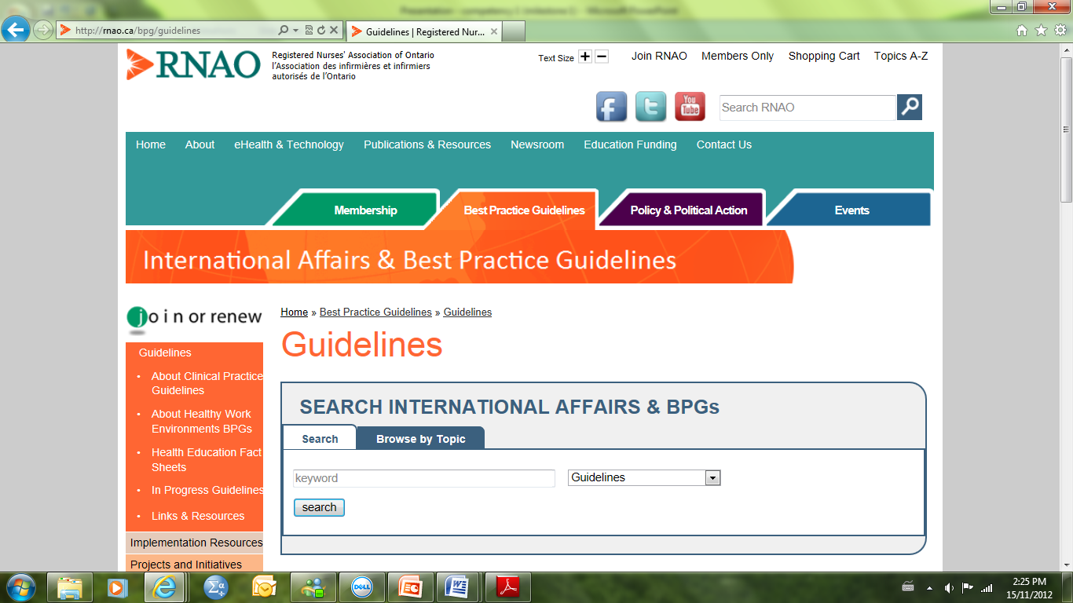
Notes:
For example, let’s look at the RNAO best practice search engine pictured here

Slide 23
Notes:
If we searched the phrase “pain management” we would find that a best practice guideline exists – a snapshot of it is pictured here
This practice guideline provides recommendations and also the ‘grade’ of the recommendation which tells us the strength of the evidence on which they are based (level C = expert opinion, level B = clinical studies (not randomized controlled trials), and level A = randomized controlled trial or meta-analysis of randomized controlled trials)
This guideline includes recommendations for assessment, re-assessment, documentation, communication, management, patient safety, and more

Slide 24
Patient Education – Health and the Internet 4
With widespread access, many individuals search the internet for health information or tools
Example: a Google search of “sore throat” retrieves over 18,000,000 results
The common use of smart phones allows individuals to access the internet in a variety of settings
Notes:
*Ask: who here has searched for diagnoses or treatments for their own symptoms in the class?
People have become ‘health consumers’ and are more active in accessing health information with increasing internet access

Slide 25
Health Literacy
Nurses play a key role in developing health literacy skills in patients by:
Helping them assess the quality of information and tools
Increasing awareness of accurate sources of information and tools

Slide 26
Education Tools 4
Online quality assessment tools
Canadian Public Health Association “Evaluating Health Information Online”
Reputable organizations’ websites
Ex. Health Canada
Notes:
It is unlikely that you will be able to teach an individual everything there is to know accessing quality health information online AND that the individual will remember everything you say
However, there are various online tools that can help people access credible health information and can be repeatedly reviewed online when help is needed
Clients/Patients can also be directed to reputable websites to use when they need to find health information

Slide 27
Individual Characteristics to Consider 4
Accessing information online may not be appropriate for all individuals and may be complicated by:
Health literacy
Language barriers
Physical barriers (e.g. Blindness)
Cognitive barriers (e.g. Alzheimer's)
Notes:
‘health literacy’ = skills to enable access, understanding, and use of information for health (according to the Canadian Council on Learning) – this includes not only literacy or the ability to read, but also the ability to read in the language with which the information is presented and the ability to appropriate weight what is read and decide whether the information is applicable

Slide 28
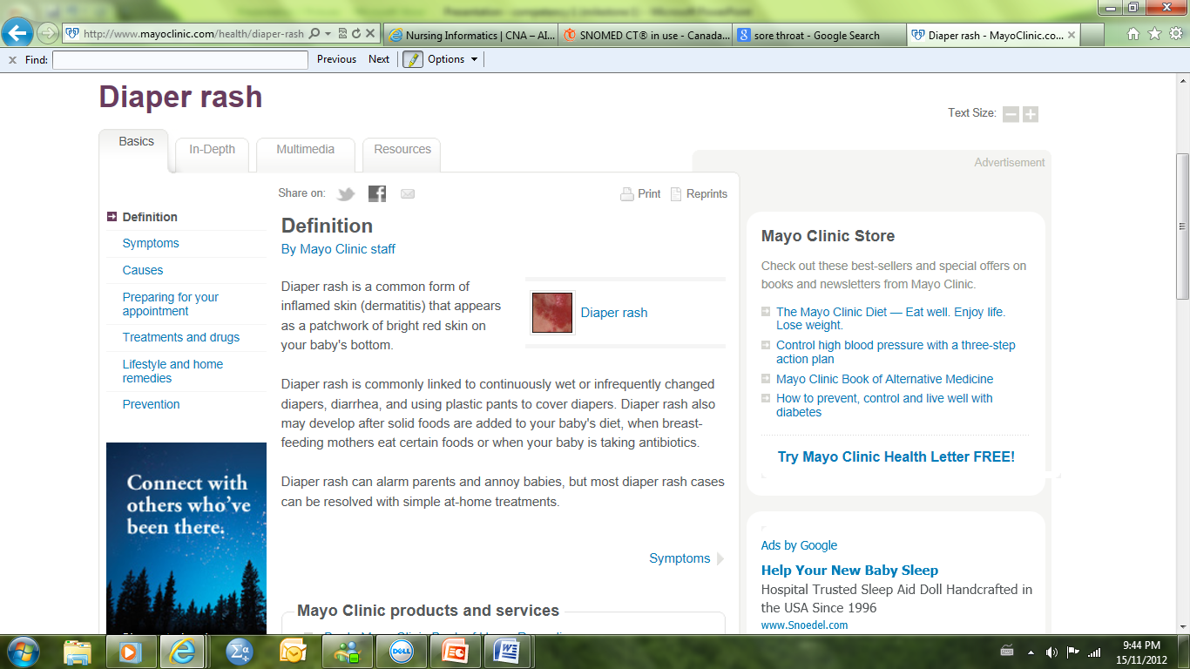
Potential Internet Use: Accessing Health Information 4
Notes:
This is what you would find if you searched “diaper rash” on the Mayo Clinic website
Note that this website includes a definition and picture, symptoms, causes, tips in preparing for a doctor’s appointment, treatments, lifestyle and home remedies, and prevention – that is a lot of information at someone’s fingertips

Slide 29
Potential Internet Use: Support 4
Notes:
Individuals may participate in online support groups that eliminate the need to travel to a specific location for a specific duration of time
Allows easy access for individuals living in rural areas

Slide 30
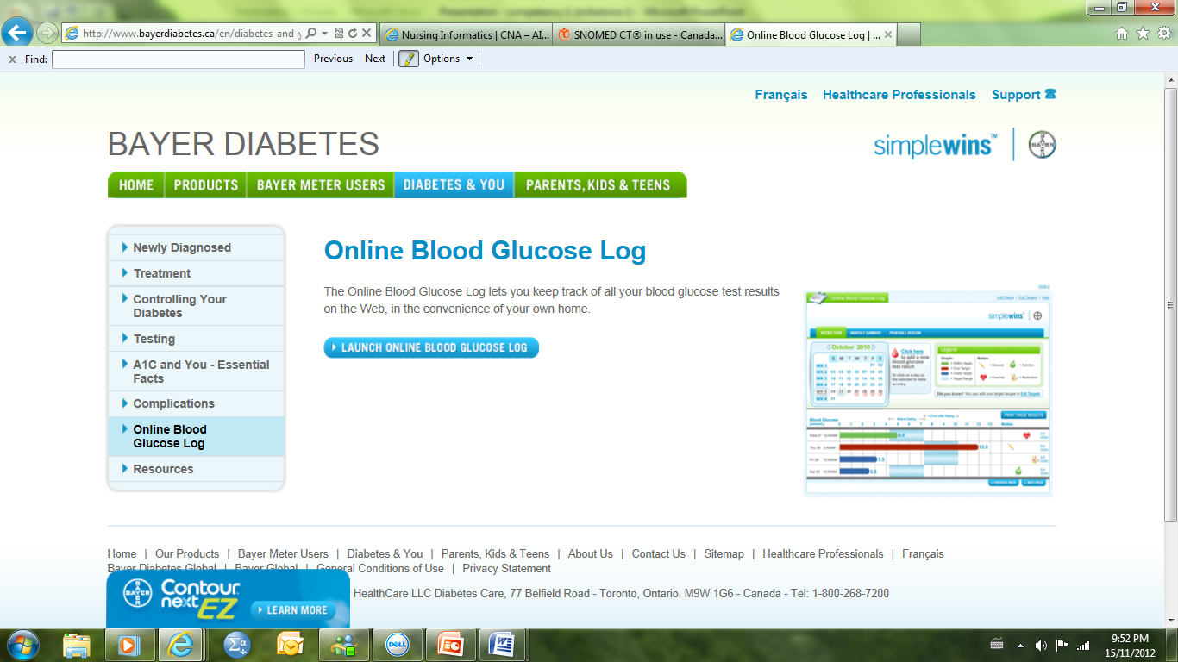
Potential Internet Use: Health Management Tools 4
Notes:
Many online chronic disease tools can be used to help individuals record, track, and make good decisions about their condition(s)

Slide 31
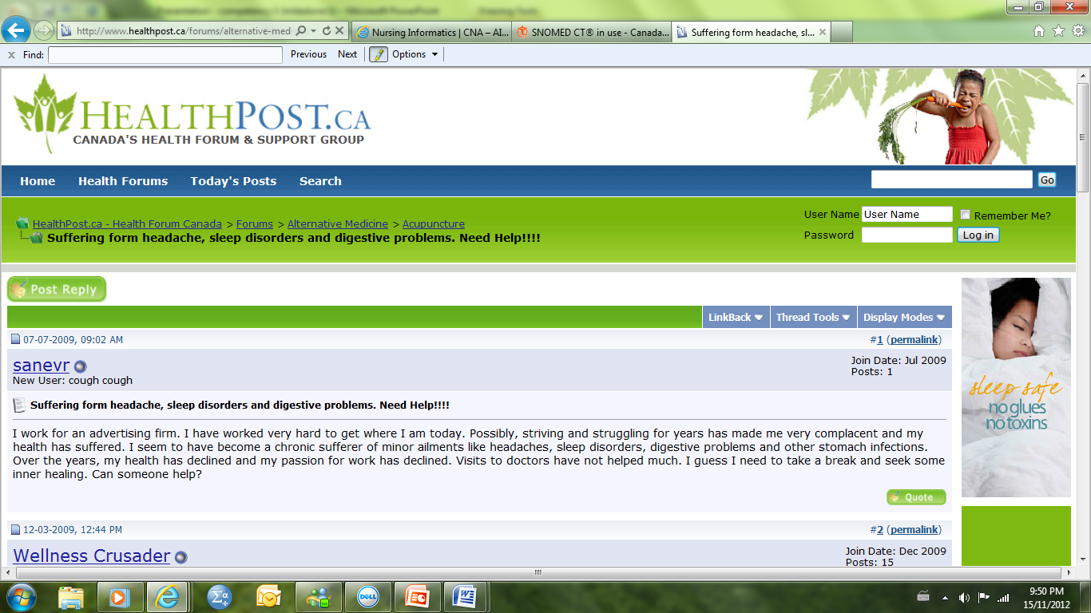
Potential Internet Use: Health Forums
Notes:
Health forums may be a helpful source of information if monitored by a qualified professional, however, many health forums contain faulty information and patients/clients should be educated in how to assess the quality of these websites just like other health information websites

Slide 32
EVIDENCE
BASED
PRACTICE
PRACTICE
BASED
EVIDENCE
Notes:
As we have seen good, quality evidence can inform nursing practice.
Data collected in nursing can also inform and advance nursing practice

Slide 33
Standardized Nursing Data12
Standardized data offers many opportunities to:
Advance nursing practice
Increases visibility of nursing contribution in patient care
Support development of nursing practice guidelines
Improve patient outcomes
Easier to identify trends in patient data
Provides information to decision-makers
Notes:
Data collection not new; technology presents new opportunities to support nurses and improve patient outcomes.
For example, if difficulties with skin integrity was an issue identified in a certain unit, managers could encourage nurses to pay special attention to this area.

Slide 34
Standardized Clinical Terminologies4,11
Common languages that describe health conditions, treatment plans, and interventions
Needed for interoperable EHRs
Two examples used in Canadian nursing: ICNP and SNOMED CT
Notes:
W

Slide 35
International Classification for Nursing Practice (ICNP) 1,6
The task of trying to standardize nursing language was undertaken by the International Council of Nurses who produced the ICNP
The ICNP includes nursing:
Interventions
Phenomena (or diagnoses), and
Outcomes
Notes:
Having a common nursing language allows for communication across different geographic locations, cultures, and health sectors
Created by the International Council of Nurses

Slide 36
Systematized Nomenclature of Medicine Clinical Terms (SNOMED CT)4, 11
Allows for clinical information to be communicated between health professionals and settings
Facilitates inter-professional teamwork
Collects international data for analysis
Notes:
This common language of medical terms opens up opportunities for studying the clinical effectiveness of interventions, but is broader in that it crosses both professional and geographic boundaries
Due to the increasing wealth of interventions and diagnoses, any common language needs to be constantly updated
This ‘language’ is currently maintained by the International Health Terminology Standards Organization (of which Canada is a member)

Slide 37
SNOMED CT and the ICNP in Canada1,6
SNOMED CT will be used in pan-Canadian electronic health records
ICNP is nursing specific, but can be integrated into inter-disciplinary systems (like SNOMED CT)
Notes:
A mapping of the ICNP to SNOMED CT found that 80% of concepts in the ICNP had matches in SNOMED CT

Slide 38
How are the terminologies used in Canadian nursing practice?
Canadian Health Outcomes for Better Information and Care (C-HOBIC) Project
This project ran from 2007 to 2010 and included a partnership between the Canadian Nurses Association and Canada Health Infoway Inc.

Slide 39
C-HOBIC 1,7
It’s goals were to:
Standardize Canadian nursing terminology with the ICNP,
Systematically capture nurse-sensitive clinical outcomes (e.g. Pain intensity, falls, pressure ulcers), and
Store the data for use in EHRs and databases.
Notes:
Sites participating in this project included those in Ontario, Saskatchewan, and Manitoba
Data was collected in acute care, complex continuing care, long-term care, and home care

Slide 40
C-HOBIC 1,7
Nurses at sites participating in C-HOBIC collected routine information during:
the admission assessment,
discharge assessment,
and, if in long-term care, on a regular basis or after a significant health event (e.g. a fall)
Nurses assessments were standardized to include: functional status, self-care, pain, nausea, fatigue, dyspnea, pressure ulcers, and falls

Slide 41
Subsequent C-HOBIC Projects 8,9
Mapping and publishing of nursing outcome categories to the ICNP
Outcome categories: functional status, therapeutic self-care, symptom management, patient safety, and patient satisfaction with nursing care
Developing of synoptic reports
Electronic charting with built-in cues of what to document and where to document it
Notes:
-the Canadian Nurses Association mapped five outcome categories with the ICNP and published this cross-mapping with the International Council of Nurses to further the use of standard clinical terminology
-the Canadian Nurses Association is currently working on developing a structured reporting system that will include specific spaces designated for the documentation of specific information

Slide 42
C-HOBIC Data and Care Outcomes
Prevent re-admissions
Nursing interventions and patient outcomes
Improved transitions (e.g. acute care to long-term care facility)

Slide 43
Uses of C-HOBIC Data 1,7
Generating nursing practice guidelines based on the evidence for nursing interventions collected in the project, and
Care planning based on the nursing resources (e.g. time) required to perform these interventions
Designing EHRs with standardized clinical terms to describe nursing interventions
Notes:
The data collected in this project is similar to that collected in a longitudinal research study with multiple sites (ON, PEI, SK), a large sample size, and a large quantity of collected data – thus the data collected in this project is of a high level of quality

Slide 44
How are the terminologies used in Canadian nursing practice?9
Registered Nurses Association of Ontario – Nursing Order Sets
Clear intervention statements based on the ICNP and SNOMED CT in Best Practice Guidelines.
Notes:
Goal to increase the standardization of nursing practice, collection of patient data, and visibility of nursing practice outcomes.

Slide 45
Scenario: a patient/client needs a heparin drip
Which health care professionals need to be able to communicate?
What electronic documents may be used in which standard clinical terminology would be important?
Notes:
We mentioned the unique, interoperability of EHRs and the requirement for standard health terminology
Now let’s consider a scenario
Health professionals involved include:
Doctor to write the order
Pharmacist to fill the order
Acute care nurse to start the drug (and be able to understand who receives what drug, in what dose, delivered via what route, at what time, etc.) and draw blood samples for monitoring
Laboratory technologist to analyze blood sample
Potentially home care nurse if the patient/client requires follow-up nursing care after discharge
Potentially family doctor to continue monitoring condition post-discharge
Documents:
Prescription form & medication administration record
Bloodwork requisition
EHRs (laboratory technician entry of bloodwork results, nursing documentation, etc.)
Potentially pre-printed orders for titration of heparin drip based on bloodwork

Slide 46
You are a student nurse and have arrived on a general surgery floor for your first shift. One of the clients/patients assigned to you is restricted to bed and has a stage II pressure ulcer on his buttocks. You notice that the nurse looking after this gentleman positioned him using a ‘donut’ to relieve pressure over the pressure ulcer, but seem to recall learning that ‘donuts’ only shift pressure to new areas of the body.
What would you do?
Notes:
Let’s re-visit this scenario
In light of what we’ve learned, would you do anything differently?
*If there is internet access in the classroom, have a student look up the RNAO best practice guidelines for pressure ulcers and determine how this situation should be handled

Slide 47
Review of Main Points
Evidence may be retrieved from a variety of sources and may be of varying levels of strength and credibility
People need to be educated on how to use online information and tools wisely
Nursing data can inform nursing practice and improve patient outcomes
Using a common, standardized language between nurses and across health professionals is key to communicating information electronically

Slide 48
References
Ball MJ, Douglas JV, & Walker, PH. (2011). Nursing informatics, Where technology and caring meet (4th ed). London: Springer.
Straus SE, Richardson WS, Glasziou P, & Haynes, RB. (2010). Evidence-based Medicine: How to practice and teach EBM (4th ed). London, Edinburgh: Churchill Livingston.
Davies B & Logan J. (2008). Reading research: A user-friendly guide for nurses and other health professionals (4th ed). Toronto, ON: Elsevier Canada
Saba VK, & McCormick, KA. (2006). Essentials of nursing informatics (4th ed). United States of America: McGraw-Hill Companies, Inc.
Office of the Auditor General of Canada. (2010). Electronic health records in Canada. Retrieved from http://www.oag-bvg.gc.ca/internet/docs/parl_oag_201004_07_e.pdf
International Council of Nurses. (2012). International classification for nursing practice. Retrieved from http://www.icn.ch/pillarsprograms/international-classification-for-nursing-practice-icnpr/
Canadian Nurses Association. (2012). Nursing informatics. Retrieved from http://www.cna-aiic.ca/en/improve-your-workplace/nursing-informatics/
Canadian Nurses Association. (2010). About C-HOBIC. Retrieved October/22, 2012, from http://www2.cna-aiic.ca/c-hobic/about/default_e.aspx
Registered Nurses Association of Ontario. (nd) Nursing Order Sets. Retrieved from http://rnao.ca/bpg/initiatives/nursing-order-sets
Canadian Nurses Association. (2011). New advances in patient safety through new advances in nursing assessments in electronic health records. Retrieved January/3, 2013, from http://www.cna-aiic.ca/en/new-advances-in-patient-safety-through-nursing-assessments-in-electronic-health-records/
11. Canada Health Infoway. (2012). Retrieved from https://sl.infoway-inforoute.ca/content/ dispPage.asp?cw_page=snomedct_e
12. Hannah, K., White, P., Nagle, L., and Pringle, D. (2009). Standardized Nursing Information in Canada for the Inclusion in Electronic Health Records: C-HOBIC. Journal of American Medical Informatics Association. 16(4), 524-530.
Special Thanks to the Centers for Disease Control and Prevention, Amanda Mills, Grace Emori, Richard Duncan, and James Gathany, for providing the pictures used in this presentation.

